Slide 1

Course 3 Deep Learning

Slide 2
AGENDA DL
01
02
03
04
INTRODUCTION
WHAT IS PERSPETRON
From ANN to DNN
WHY &HOW

Slide 3
01
INTRODUCTION

Slide 4
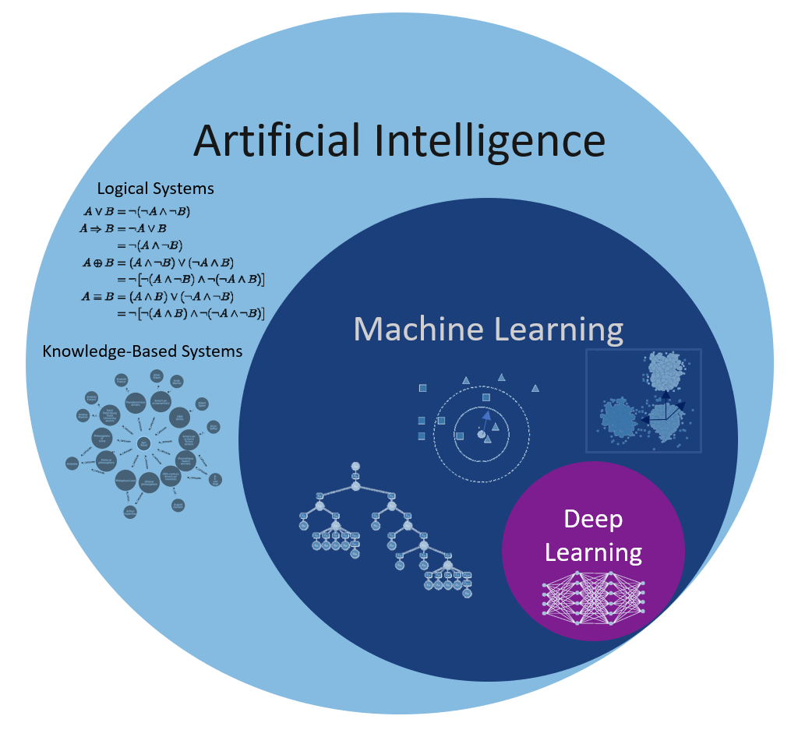
Differentiate between
AI, Machine Learning and Deep Learning

Slide 5
Artificial Intelligence is a technique which enables machines to mimic human behavior.
Machine Learning is a subset of AI technique which uses statistical methods to enable machines to improve with experience.
Deep learning is a subset of ML which make the computation of multi-layer neural network feasible. It uses Neural networks to simulate human-like decision making.

Slide 6
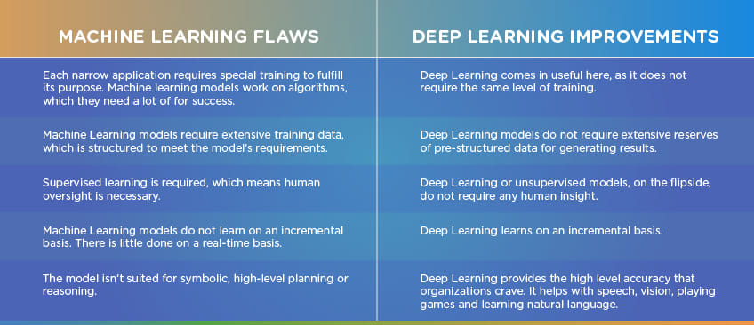

Slide 7
History of Deep Learning
Ideas and Milestones
• 1943: Neural networks
• 1957-62: Perceptron
• 1970-86: Backpropagation, RBM, RNN
• 1979-98: CNN, MNIST, LSTM, Bidirectional RNN
• 2006: “Deep Learning”, DBN
• 2009: ImageNet + AlexNet
• 2014: GANs
2016-17: AlphaGo, AlphaZero
• 2017: 2017-19: Transformers

Slide 8
02
WHAT IS PERSPETRON
DEEP LEARNING

Slide 9
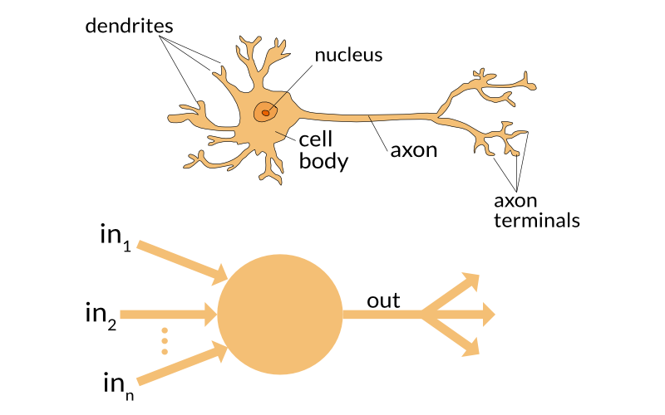
What is Perceptron ? And How does it Work?

Slide 10
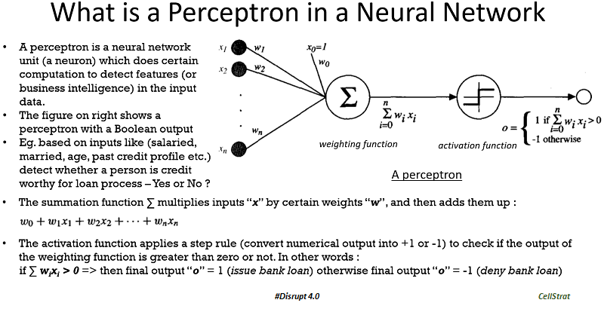
Perceptron Math fig

Slide 11
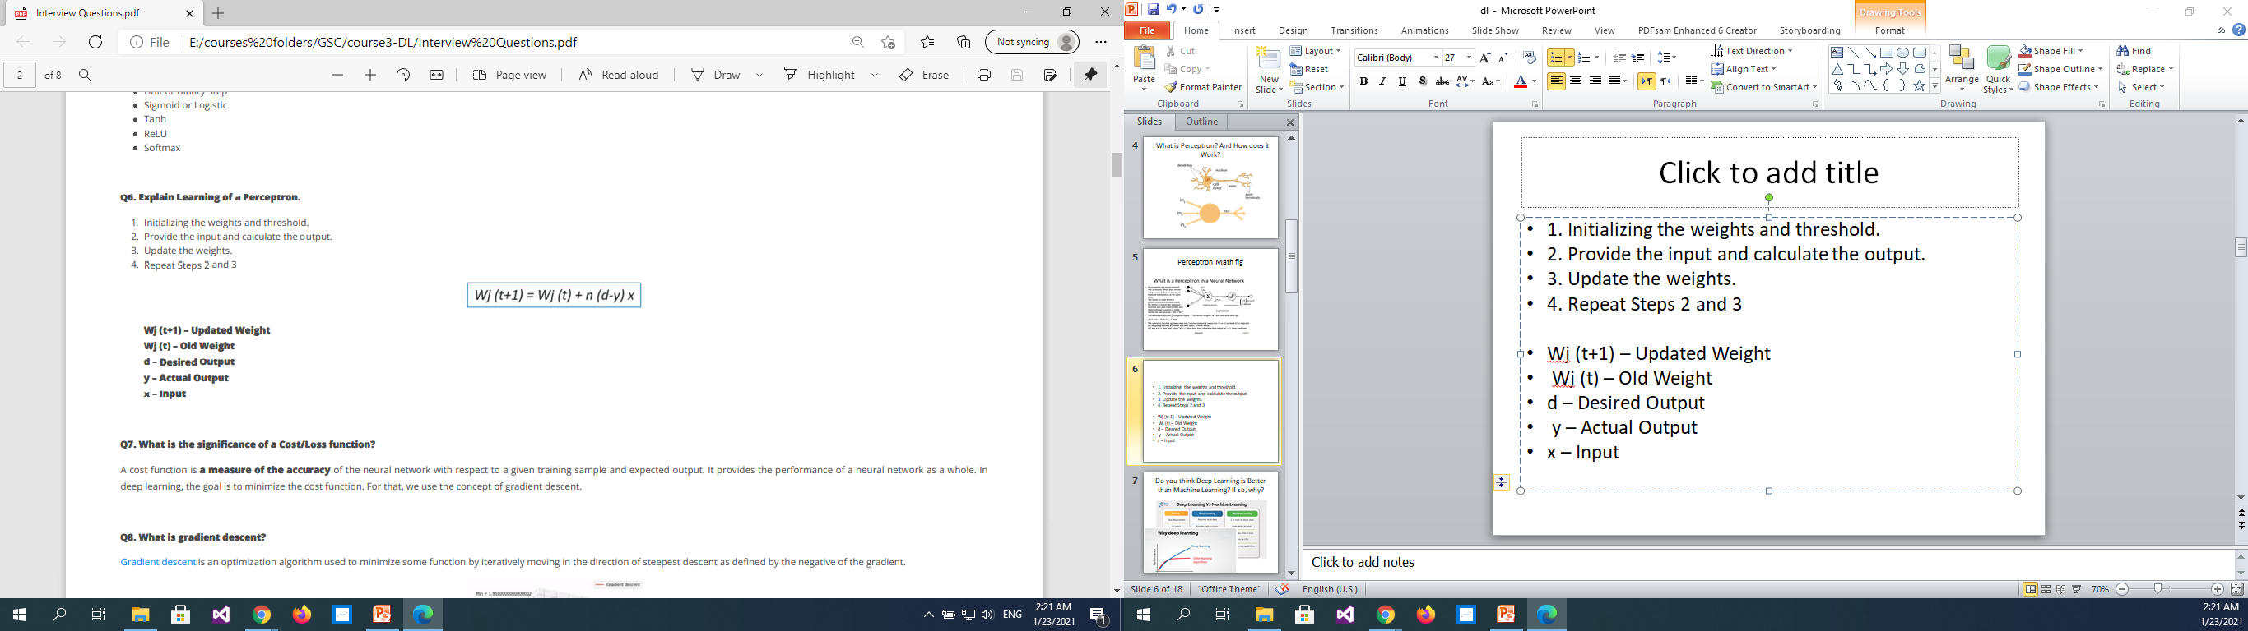
Algorithm
1. Initializing the weights and threshold.
2. Provide the input and calculate the output.
3. Update the weights.
4. Repeat Steps 2 and 3
Wj (t+1) – Updated Weight
Wj (t) – Old Weight
d – Desired Output
y – Actual Output
x – Input

Slide 12
03
From ANN to DNN

Slide 13
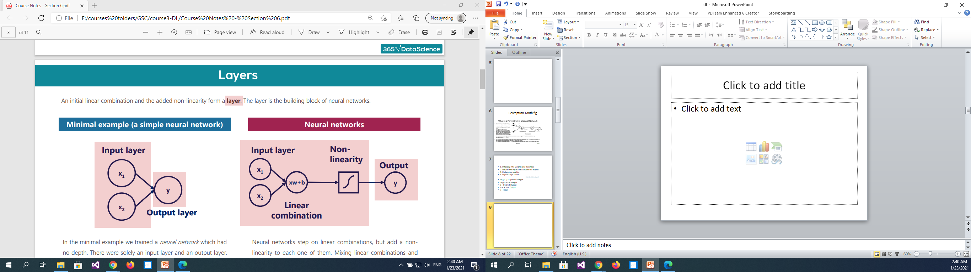
What is Perceptron ? And How does it Work?

Slide 14
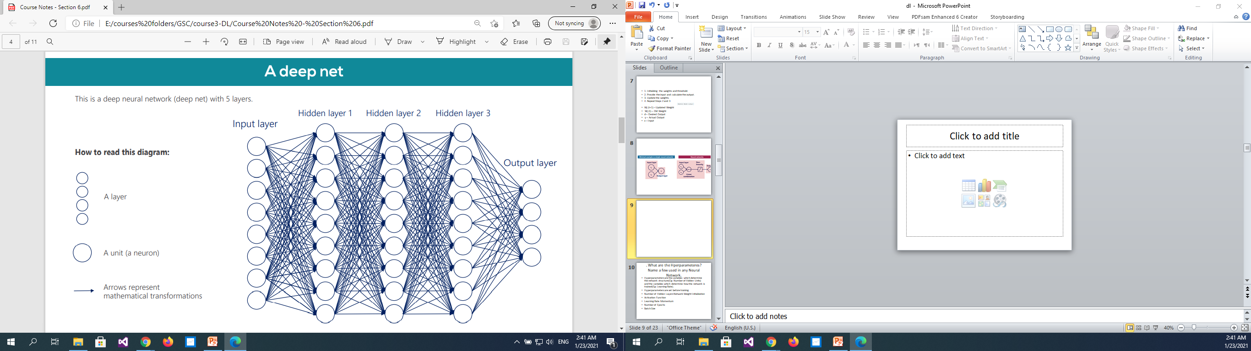

Slide 15
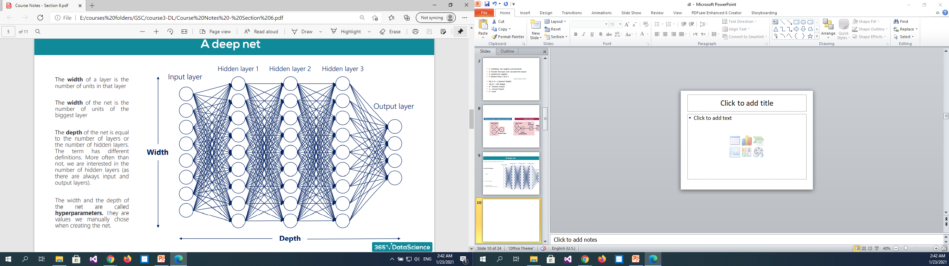

Slide 16
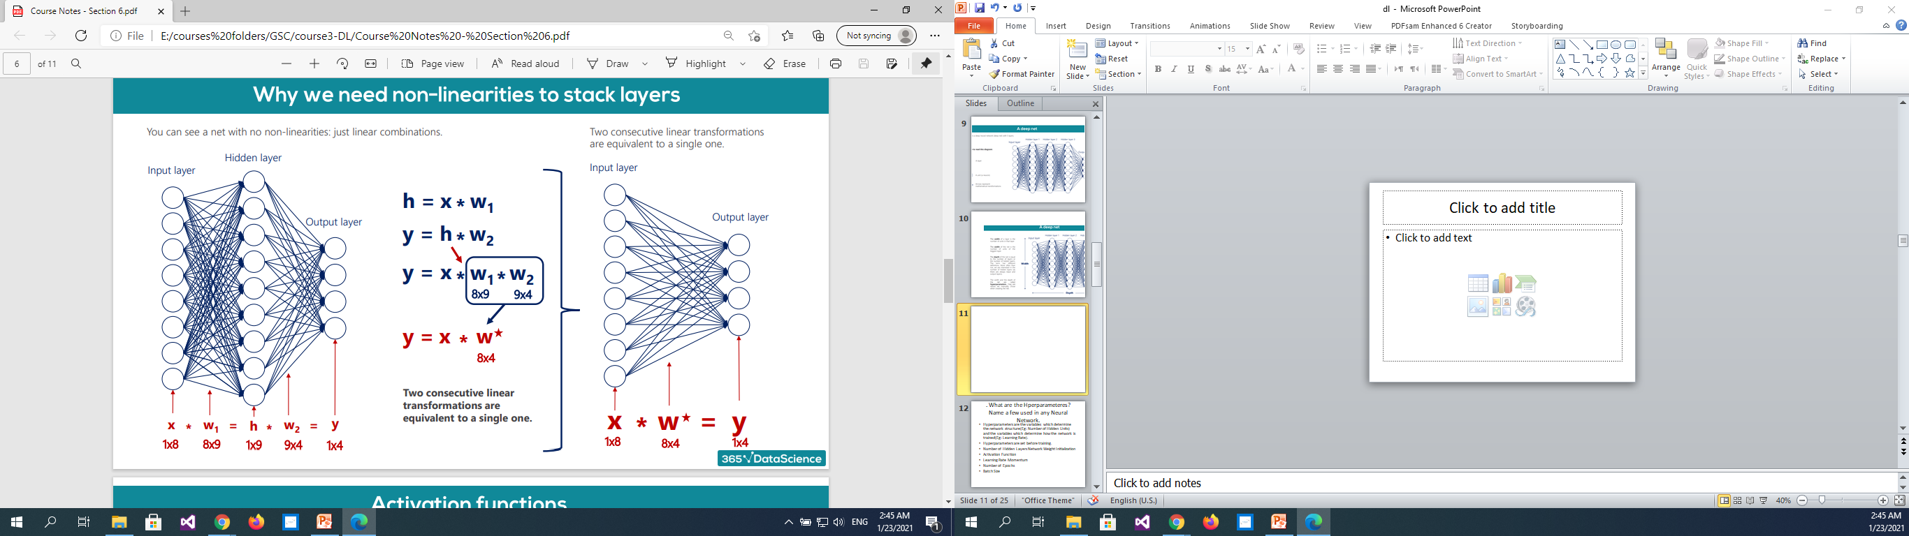

Slide 17
What are the Hperparameteres? Name a few used in any Neural Network.
Hyper parameters are the variables which determine the network structure(Eg: Number of Hidden Units) and the variables which determine how the network is trained(Eg: Learning Rate).
Hyper parameters are set before training.
Number of Hidden Layers
Network Weight Initialization
Activation Function
Learning Rate Momentum
Number of Epochs
Batch Size

Slide 18
Explain the different Hyper parameters related to Network and Training.
The number of Hidden Layers: Many hidden units within a layer with regularization techniques can increase accuracy. Smaller number of units may cause underfitting.
Network Weight Initialization: Ideally, it may be better to use different weight initialization schemes according to the activation function used on each layer. Mostly uniform distribution is used.
Activation function: Activation functions are used to introduce nonlinearity to models, which allows deep learning models to learn nonlinear prediction boundaries.
Training Hyperparameters
Learning Rate: The learning rate de+nes how quickly a network updates its parameters. Low learning rate slows down the learning process but converges smoothly. Larger learning rate speeds up the learning but may not converge.
Momentum: Momentum helps to know the direction of the next step with the knowledge of the previous steps. It helps to prevent oscillations. A typical choice of momentum is between 0.5 to 0.9.
The number of epochs: Number of epochs is the number of times the whole training data is shown to the network while training. Increase the number of epochs until the validation accuracy starts decreasing even when training accuracy is increasing(over fitting).
Batch size: Mini batch size is the number of sub-samples given to the network after which parameter update happens. A good default for batch size might be 32. Also try 32, 64, 128, 256, and so on.

Slide 19
What is the significance of a Cost/Loss function?
A cost function is a measure of the accuracy of the neural network with respect to a given training sample and expected output. It provides the performance of a neural network as a whole. In
deep learning, the goal is to minimize the cost function.

Slide 20
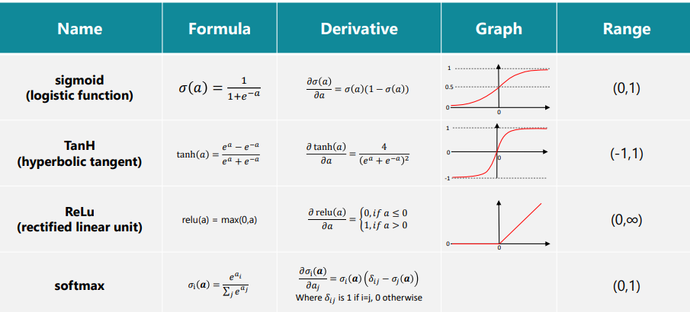
What are the activation functions

Slide 21
04
WHY &HOW

Slide 22
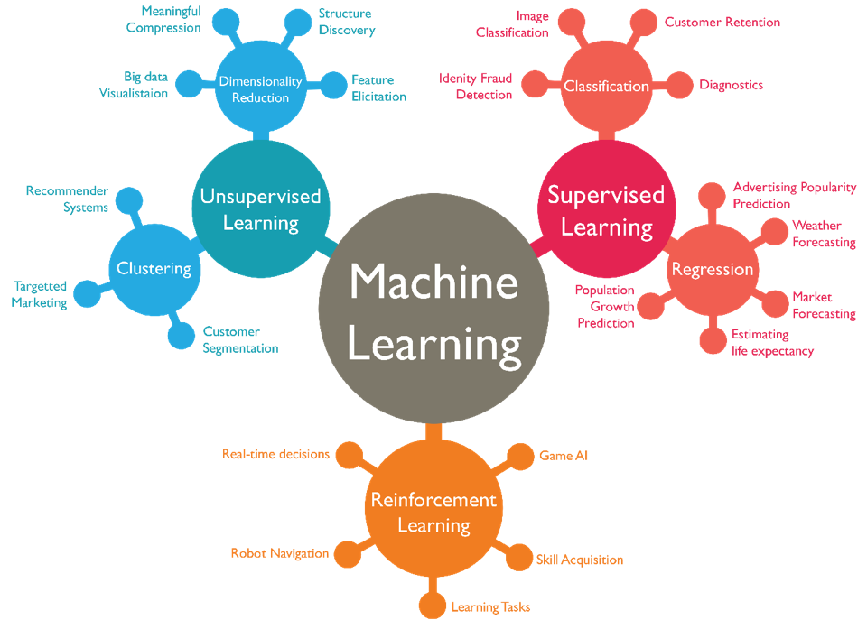
types of machine learning

Slide 23
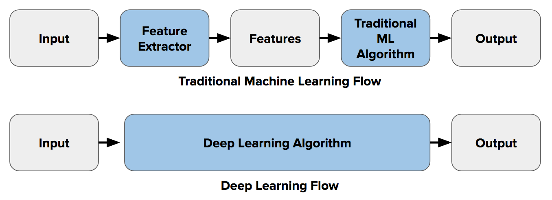
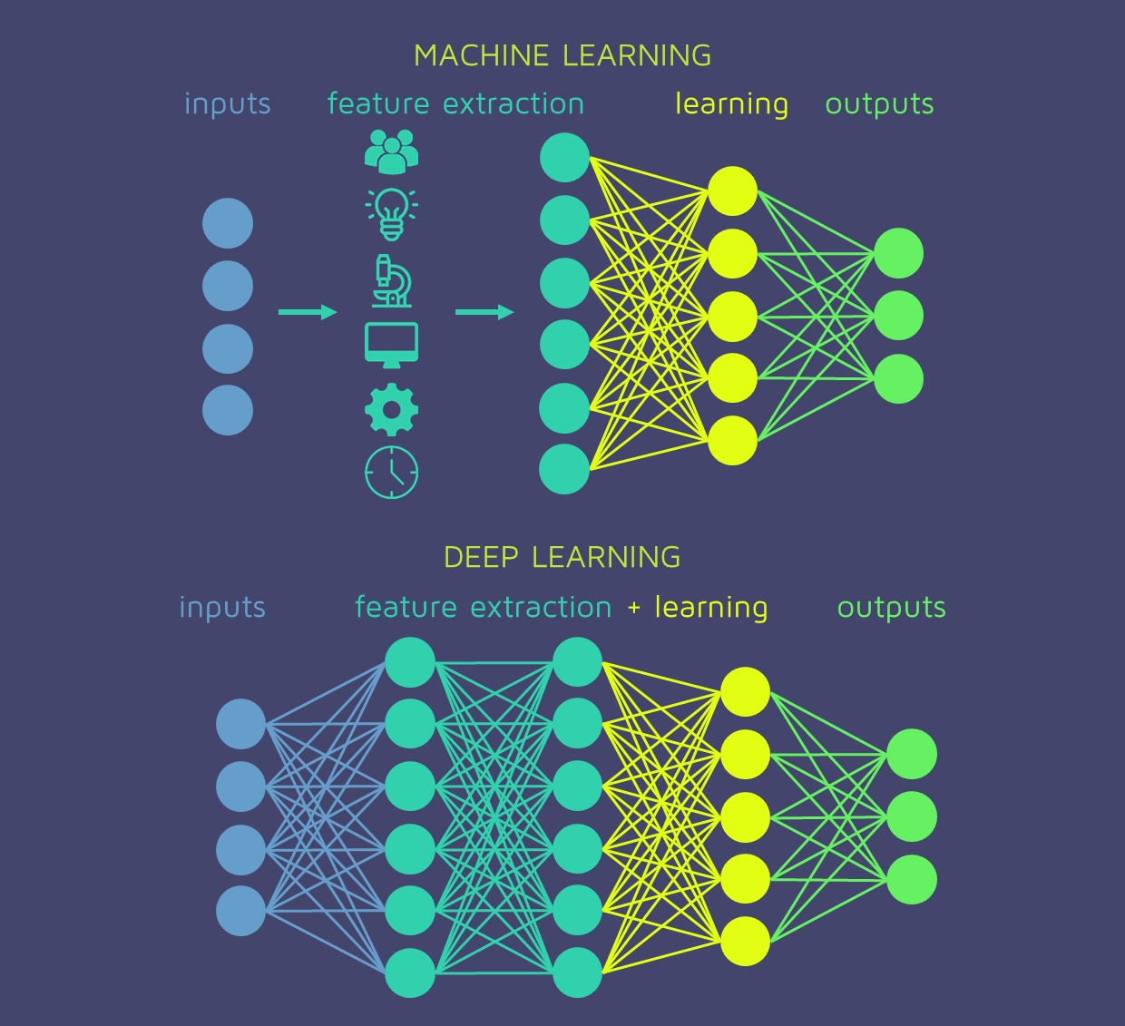

Slide 24
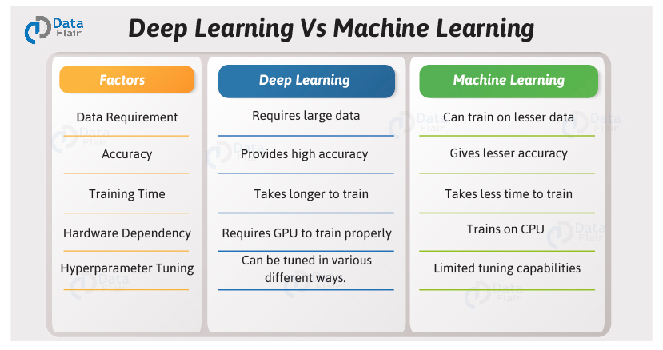
Do you think Deep Learning is Better than Machine Learning? If so, why?

Slide 25
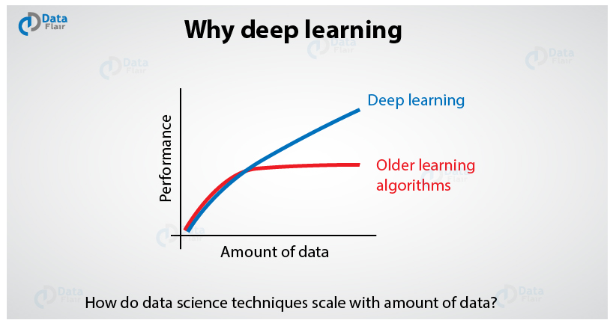

Slide 26
Types of Deep Learning Algorithms
Convolutional Neural Networks (CNNs)
Recurrent Neural Networks (RNNs)
Generative Adversarial Networks (GANs)
Radial Basis Function Networks (RBFNs)
Multilayer Perceptrons (MLPs)
Self Organizing Maps (SOMs)
Deep Belief Networks (DBNs)
Restricted Boltzmann Machines( RBMs)
Autoencoders

Slide 27
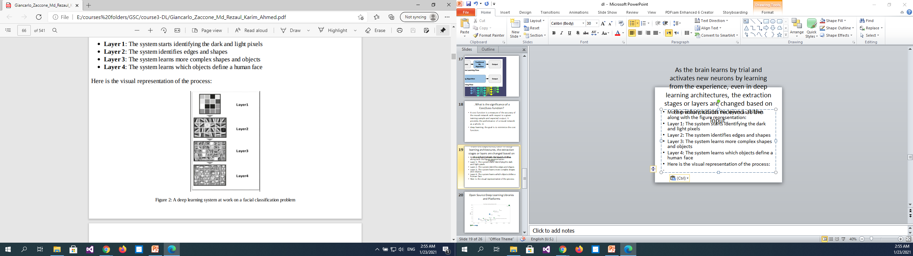
As the brain learns by trial and activates new neurons by learning from the experience, even in deep learning architectures, the extraction stages or layers are changed based on the information received at the input.
More precisely, it builds the layers as follows along with the figure representation:
Layer 1: The system starts identifying the dark and light pixels
Layer 2: The system identifies edges and shapes
Layer 3: The system learns more complex shapes and objects
Layer 4: The system learns which objects define a human face
Here is the visual representation of the process:

Slide 28
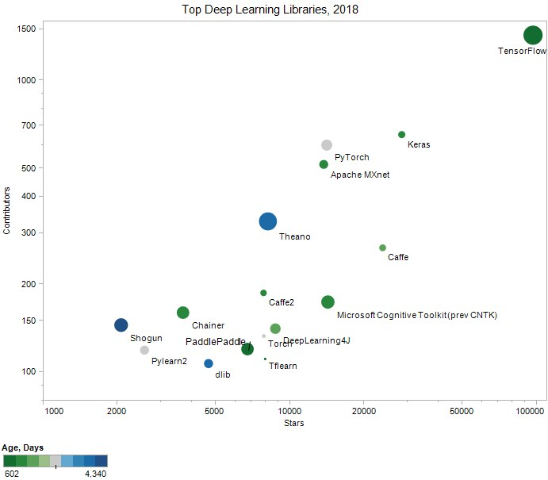
Open Source Deep Learning Libraries and Platforms

Slide 29
There are two main reasons it has only recently become useful:
Deep learning requires large amounts of labeled data. For example, driverless car development requires millions of images and thousands of hours of video.
B. Deep learning requires substantial computing power. High-performance GPUs have a parallel architecture that is efficient for deep learning. When combined with clusters or cloud computing, this enables development teams to reduce training time for a deep learning network from weeks to hours or less.

Slide 30
Examples of Deep Learning (DL) at work listed below as:
a. Deep learning applications are used in industries from automated driving to medical devices.
b. Automated Driving: Automotive researchers are using deep learning to automatically detect objects such as stop signs and traffic lights. In addition, deep learning is used to detect pedestrians, which helps decrease accidents.
c. Aerospace and Defense: Deep learning is used to identify objects from satellites that locate areas of interest and identify safe or unsafe zones for troops.
d. Medical Research: Cancer researchers are using deep learning to automatically detect cancer cells. Teams at UCLA built an advanced microscope that yields a high- dimensional data set used to train a deep learning application to accurately identify cancer cells.
e. Industrial Automation: Deep learning is helping to improve worker safety around heavy machinery by automatically detecting when people or objects are within an unsafe distance of machines.
f. Electronics: Deep learning is being used in automated hearing and speech translation. For example, home assistance devices that respond to your voice and know your preferences are powered by deep learning applications.

Slide 31
Limitations of Deep Learning
The systems need 10,000+ examples to learn a concept like cows. Humans only need a handful of examples.
Deep Learning cannot explain how the systems got an answer.
Deep Learning lacks common sense. This makes the systems fragile and when errors are made, the errors can be very large.

Slide 32
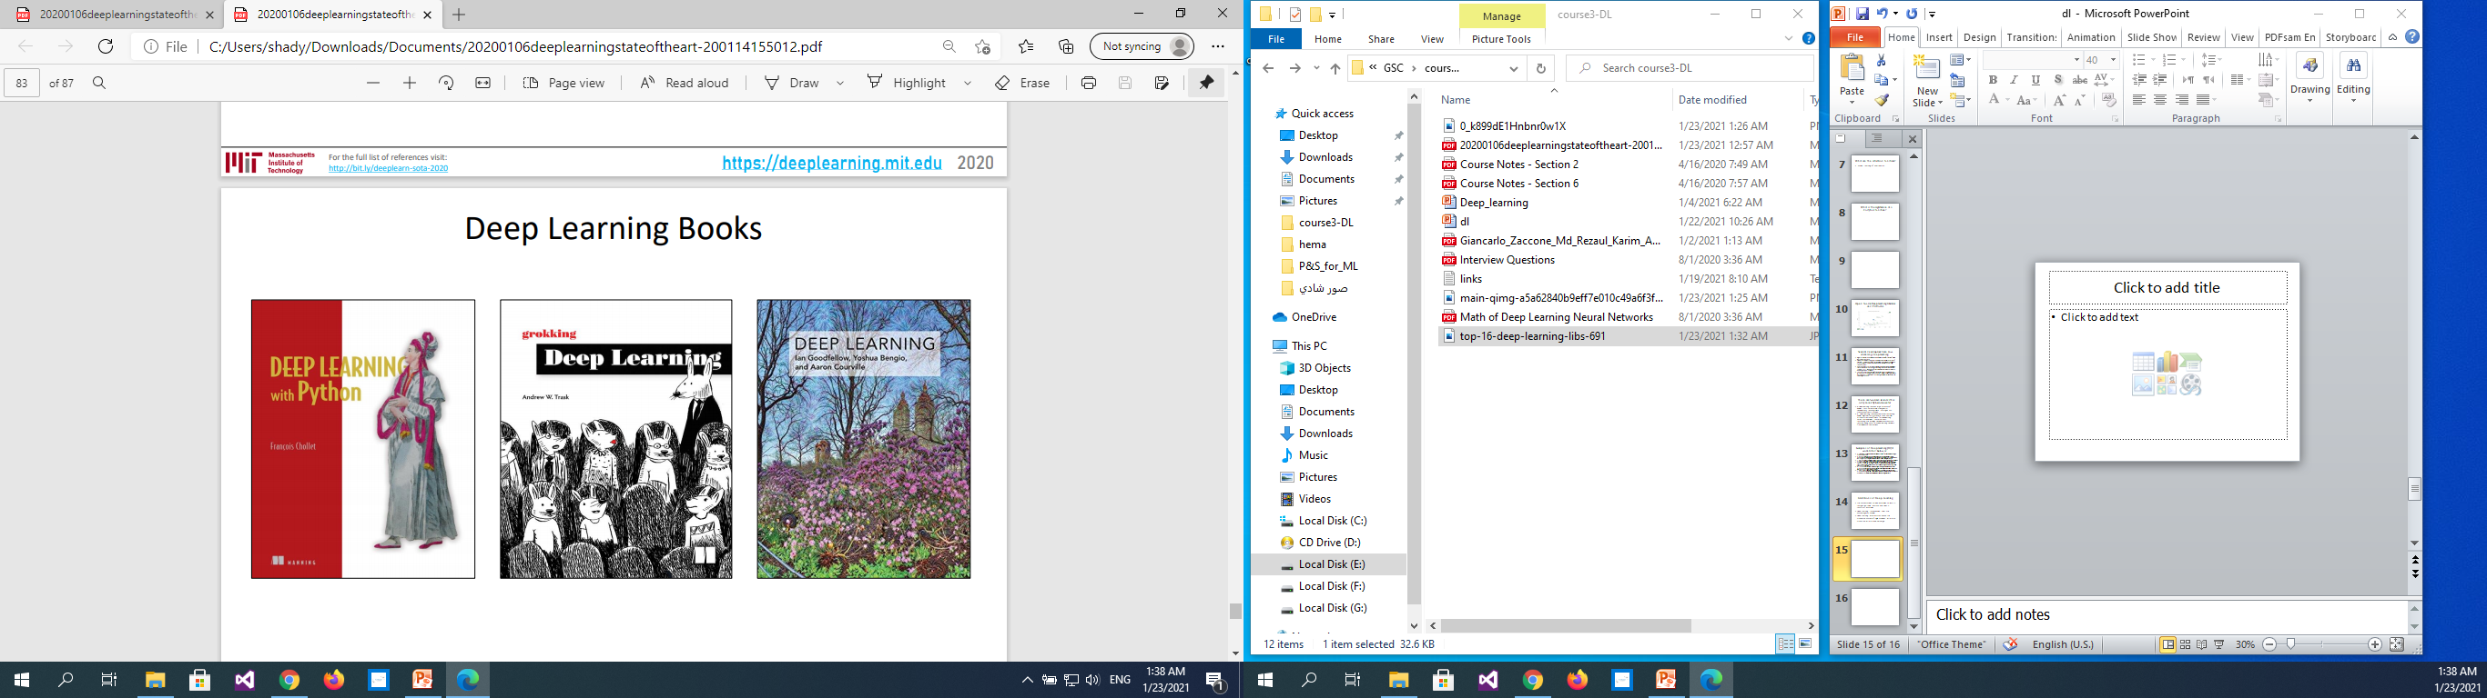

Slide 33
Usefull Links
https://appliedgo.net/perceptron/
http://alexlenail.me/NN-SVG/index.html
https://playground.tensorflow.org/#activation=sigmoid&batchSize=10&dataset=gauss&regDataset=reg-plane&learningRate=0.03&regularizationRate=0&noise=5&networkShape=6&seed=0.63653&showTestData=false&discretize=false&percTrainData=50&x=true&y=true&xTimesY=false&xSquared=false&ySquared=false&cosX=false&sinX=false&cosY=false&sinY=false&collectStats=false&problem=classification&initZero=false&hideText=false
https://www.asimovinstitute.org/neural-network-zoo/

Slide 34
PARCTICE
Your Turn Now

Slide 35
THANKS
Any questions?

